Slide 1
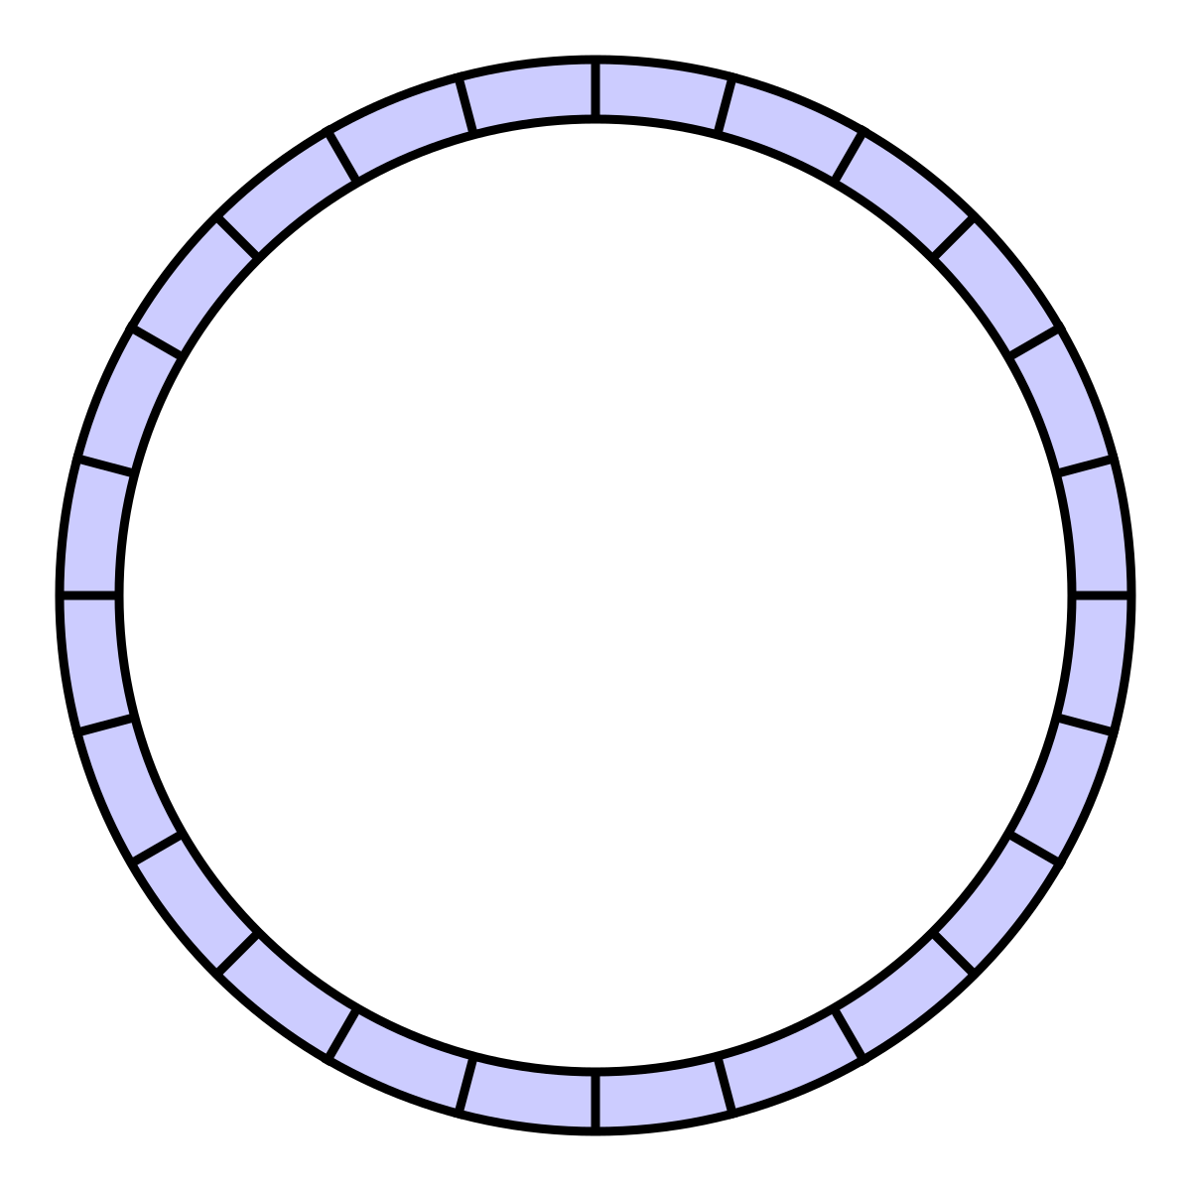
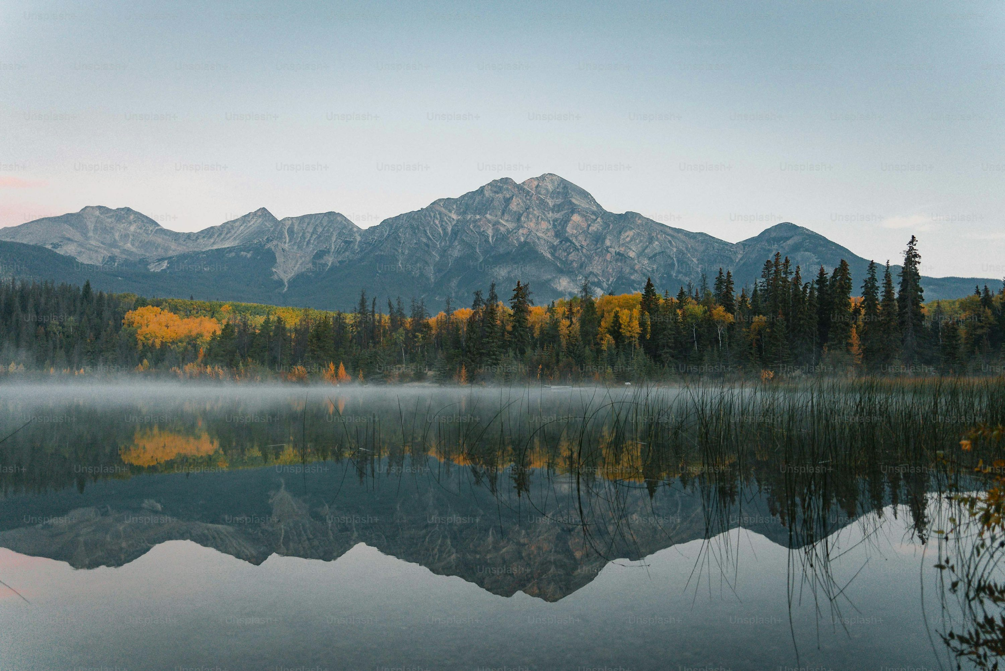






Place Rings at all four corners to hang the banner by strings
WHERE WATER FLOWS, LIFE GROWS
22 MARCH
WORLD WATER DAY
Come!!!
Let us Take Steps
Save Water
Save Streams
2026 “Water and Gender”
Date: March 22 - May 22
Location: Our River Bank, location
Contact: Local ROW Volunteer/Coordinator
HQ Contact: rowfoundation@gmail.com

Slide 2
Banner (Slide 1) for conducting WWD – Ensure four corners are punched and rings placed for hanging the banner
Badges and Logos
Come!!!
Let us Take Steps
Save Water
Save Streams
Print ~4” x 4” Badge ,wear using safetypin
Date: March 22 – May 22 (Do not place the year)
Location: Provide your location: Example: Bhilangana River Bank, Ghansali, UK
Contact: Local ROW Volunteer/Coordinator at – your Mobile no./email address
HQ Contact: rowfoundation@gmail.com
Steps to undertake WWD activities : see this link : https://rowfoundation.org/old/content/row/Steps-to-undertake-WWD-event.pdf

